Slide 1
SUMMER INTERNSHIP PROJECT Micro learning in Data science
Name : k harsha vardhan reddy
Regno: 11806793

Slide 2
CERTIFICATE

Slide 3
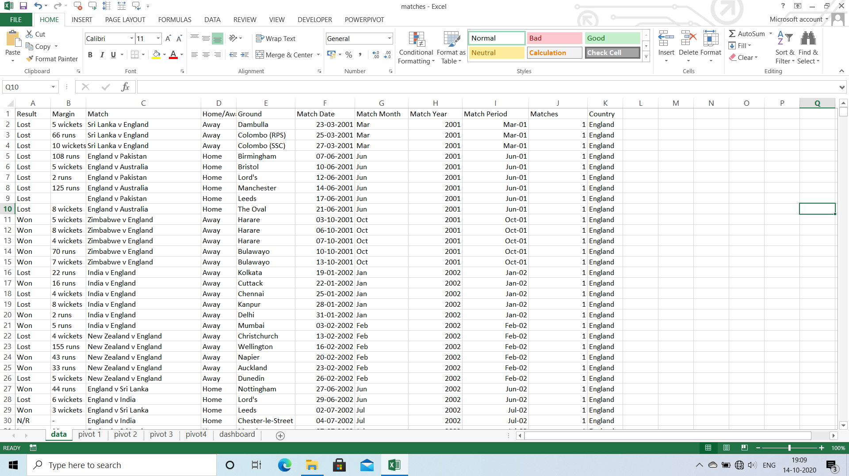

Slide 4
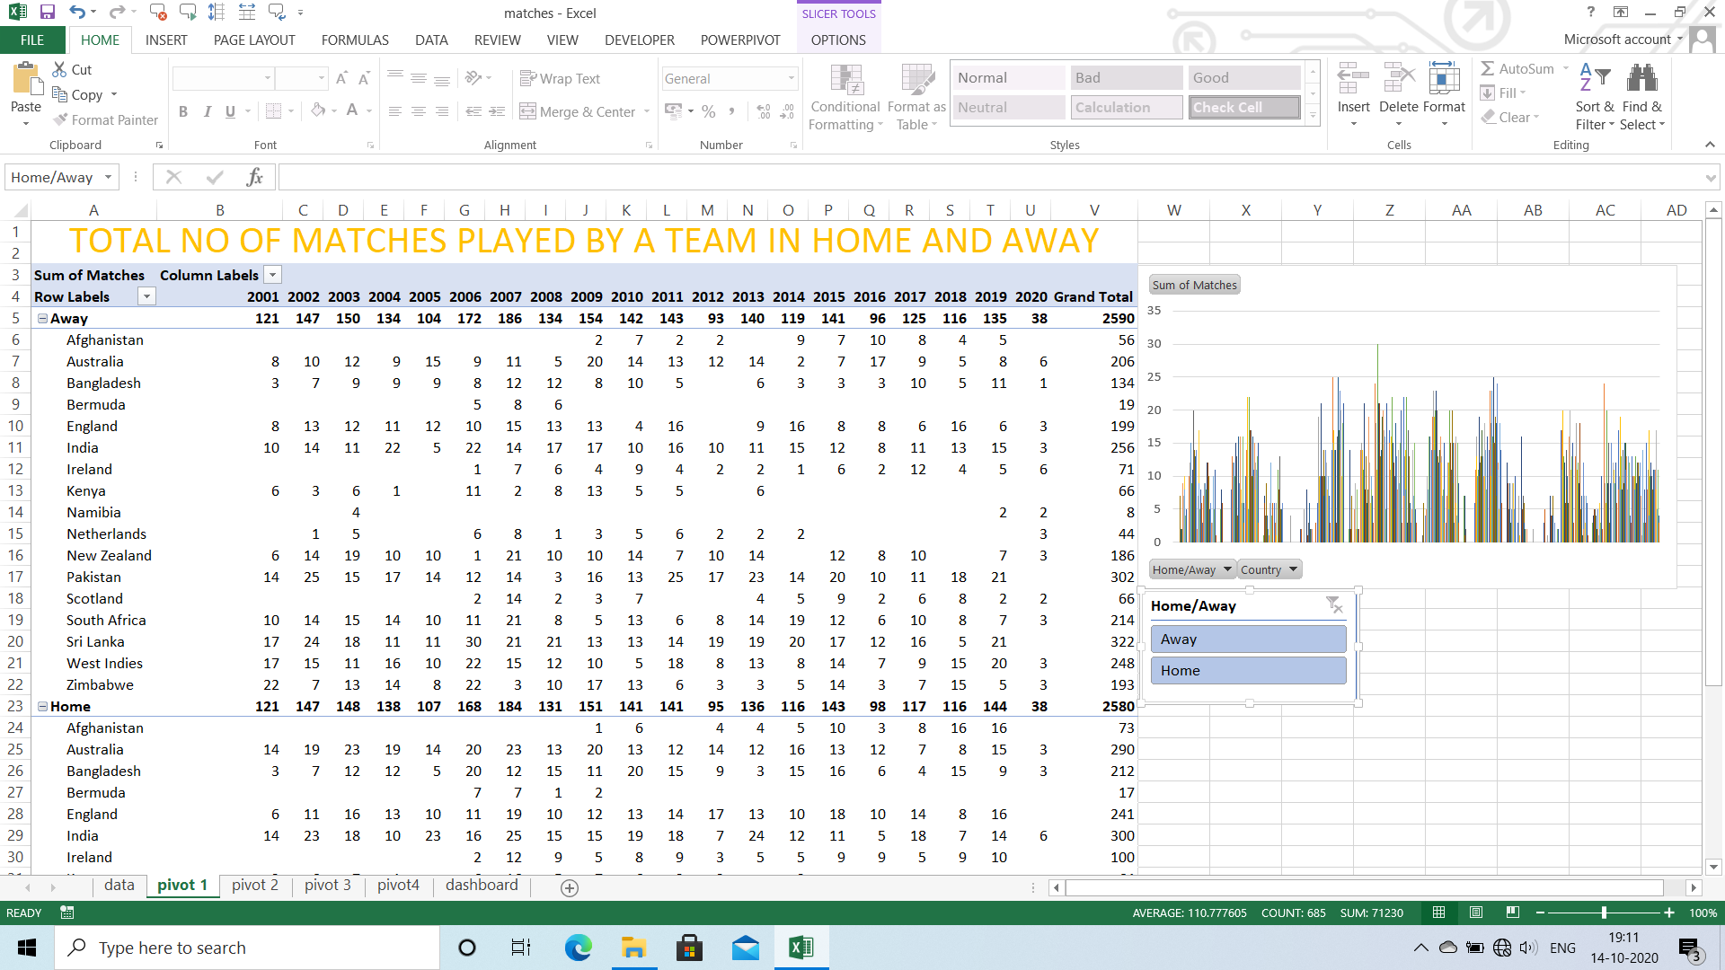

Slide 5
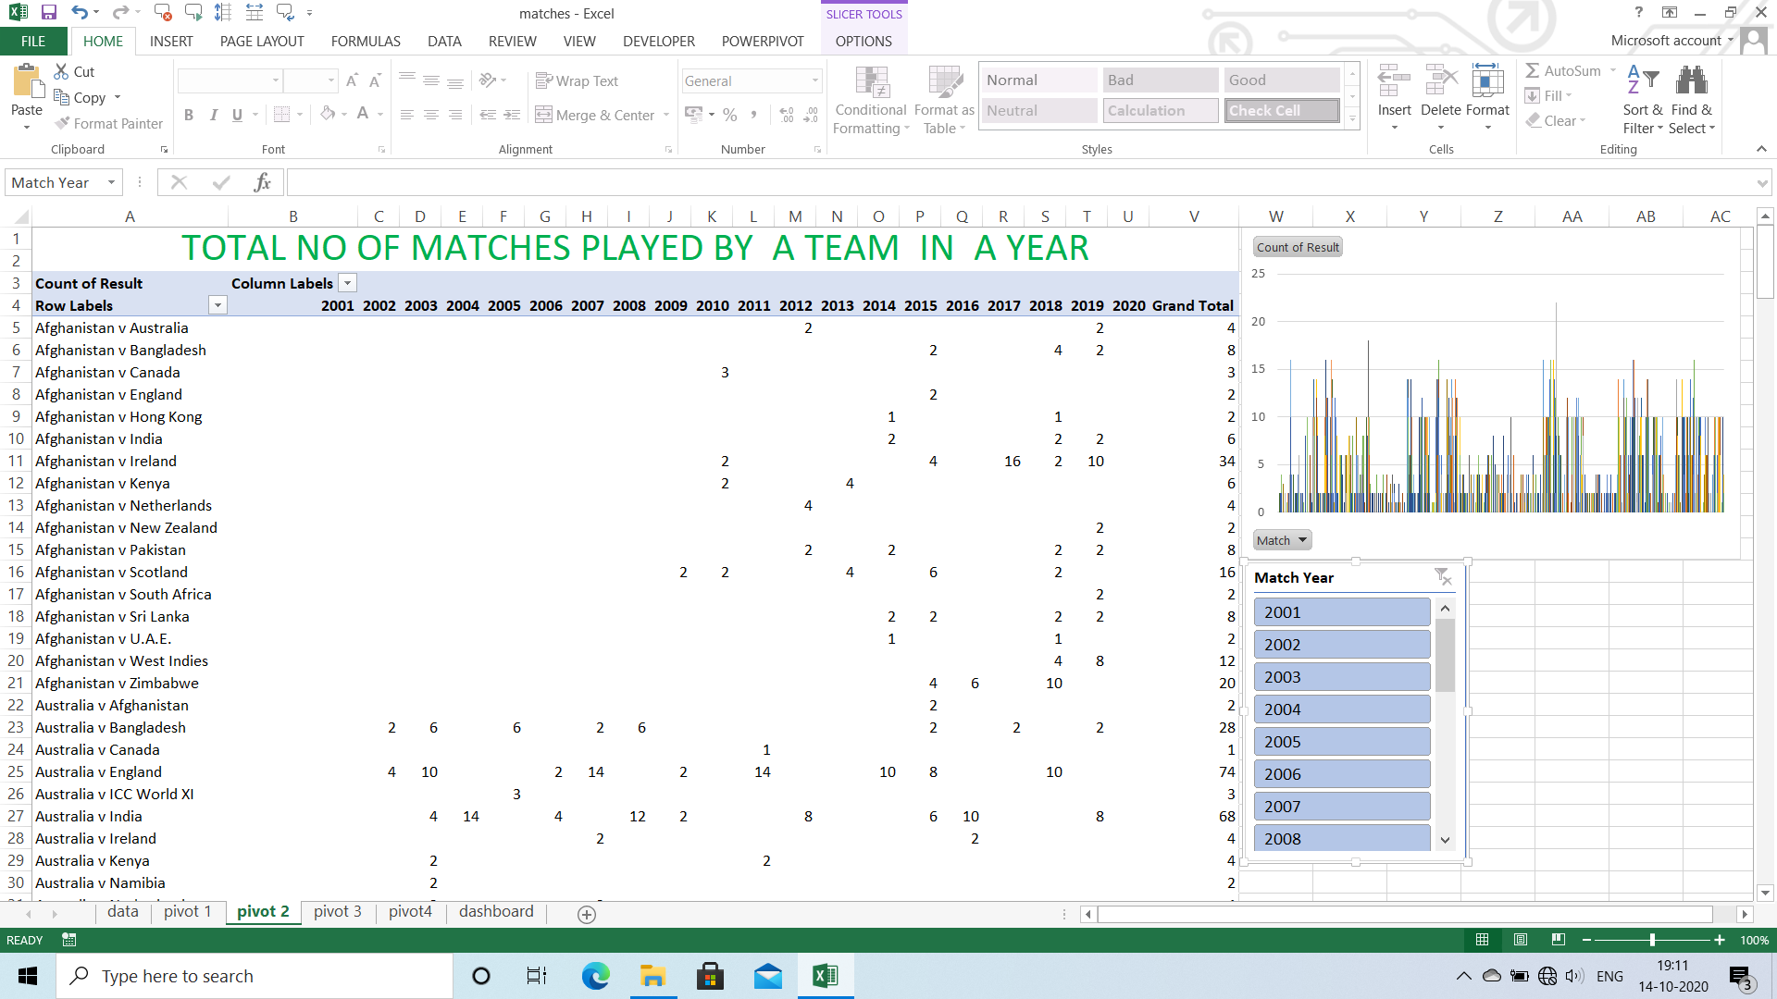

Slide 6
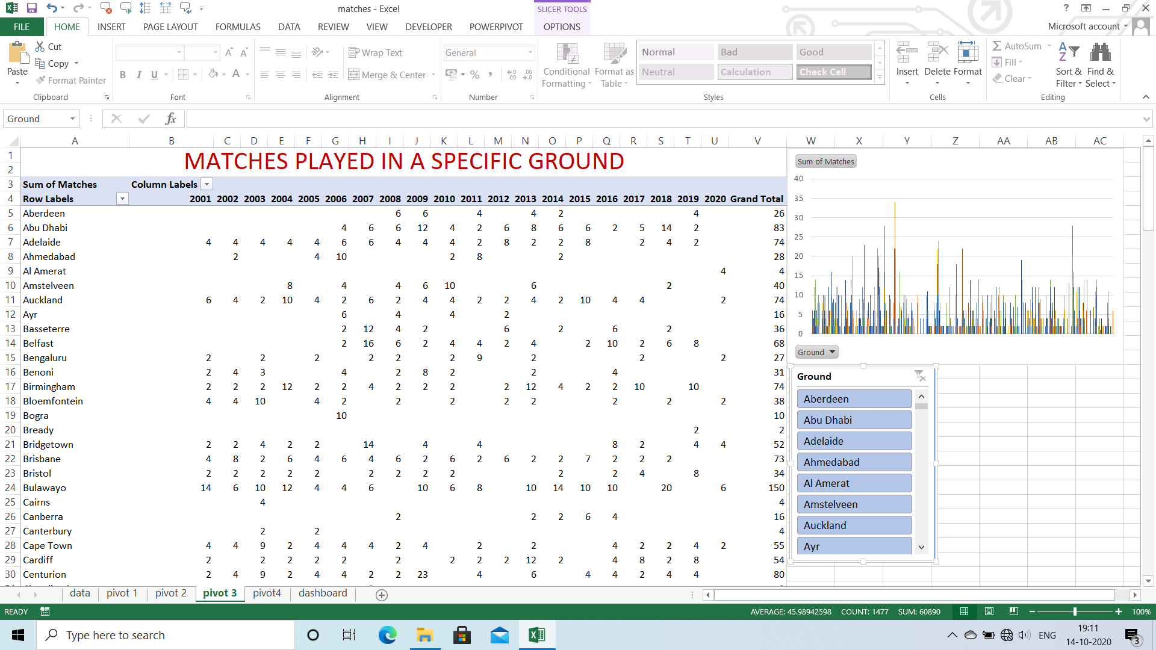

Slide 7
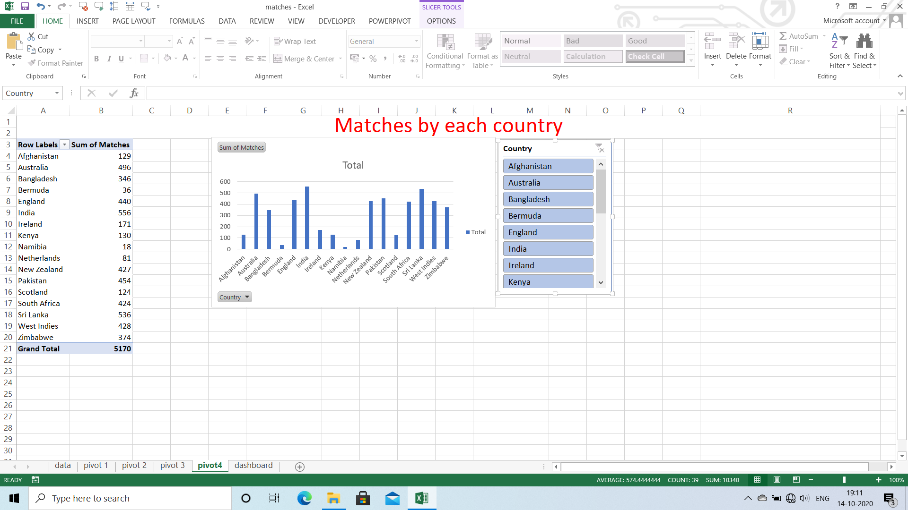

Slide 8
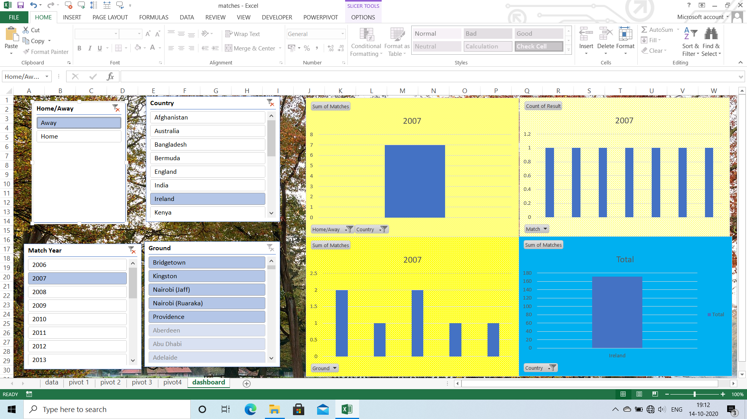
DASH BOARD

Slide 9
TABLEAU

Slide 10
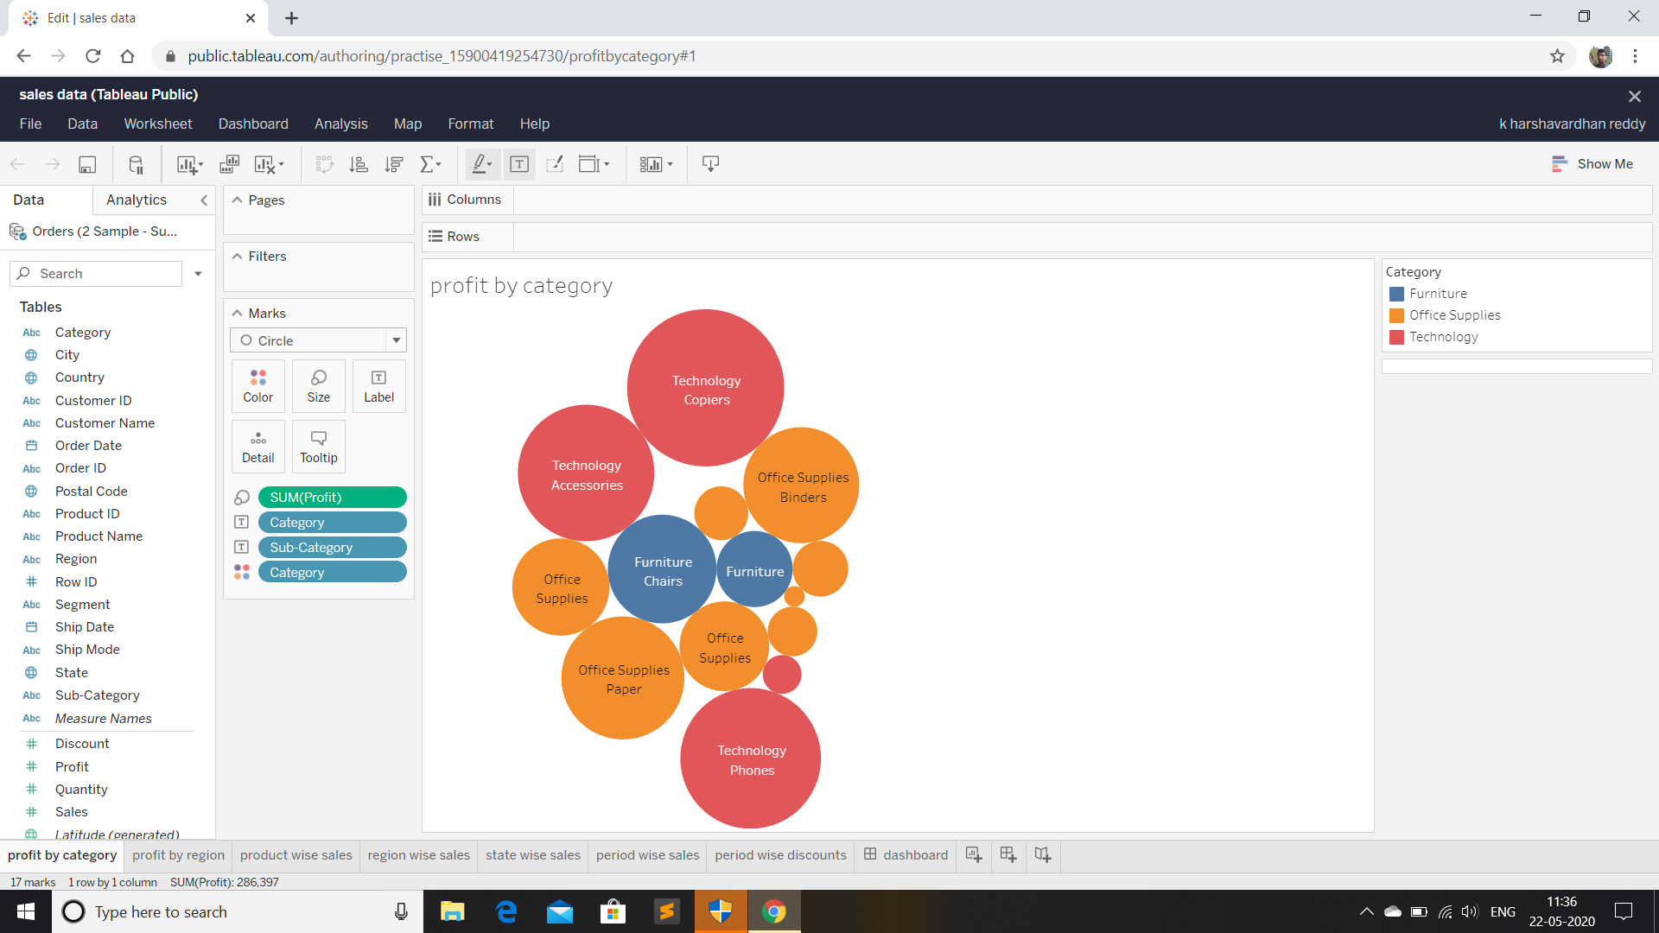
Profit by category

Slide 11
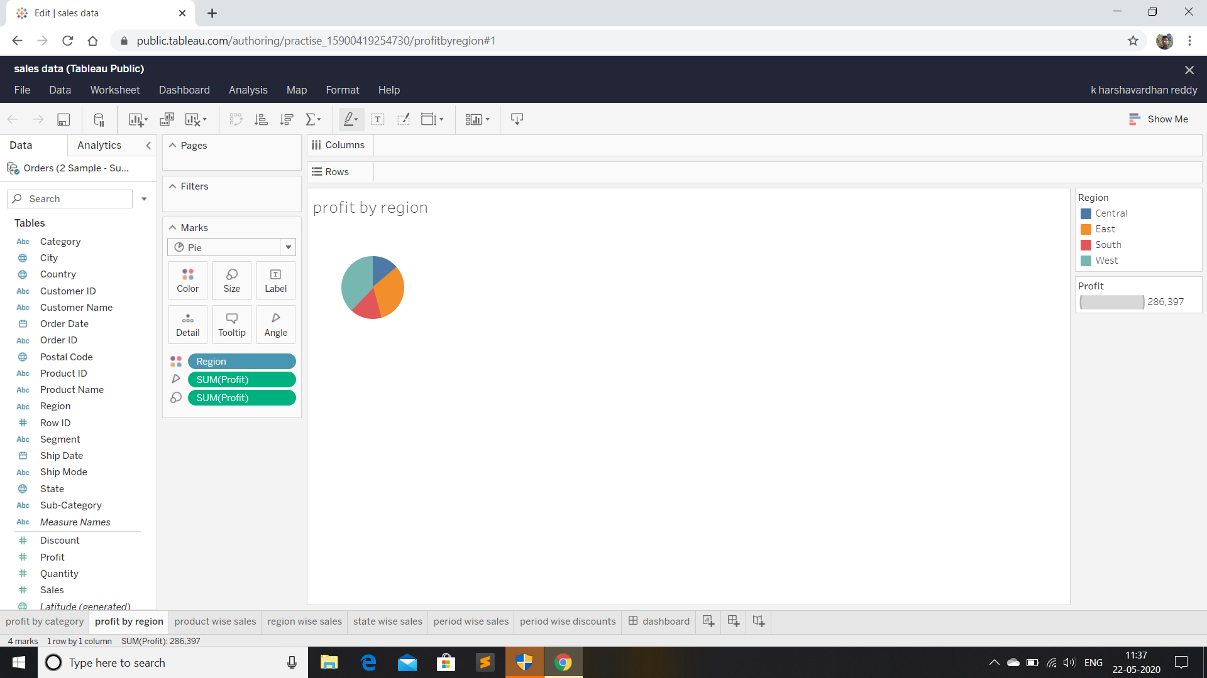
Profit by region

Slide 12
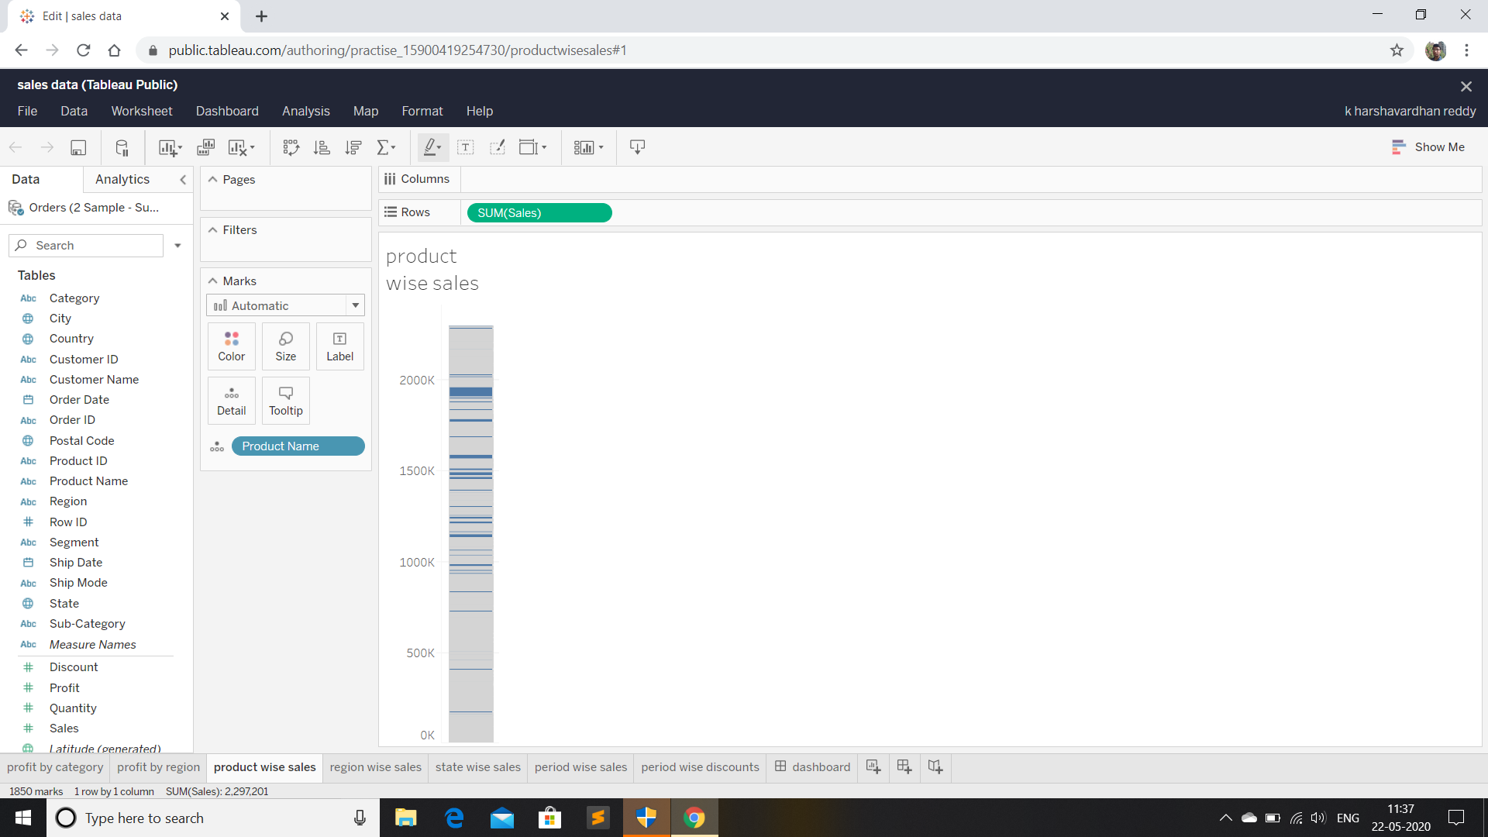
Product wise sales

Slide 13
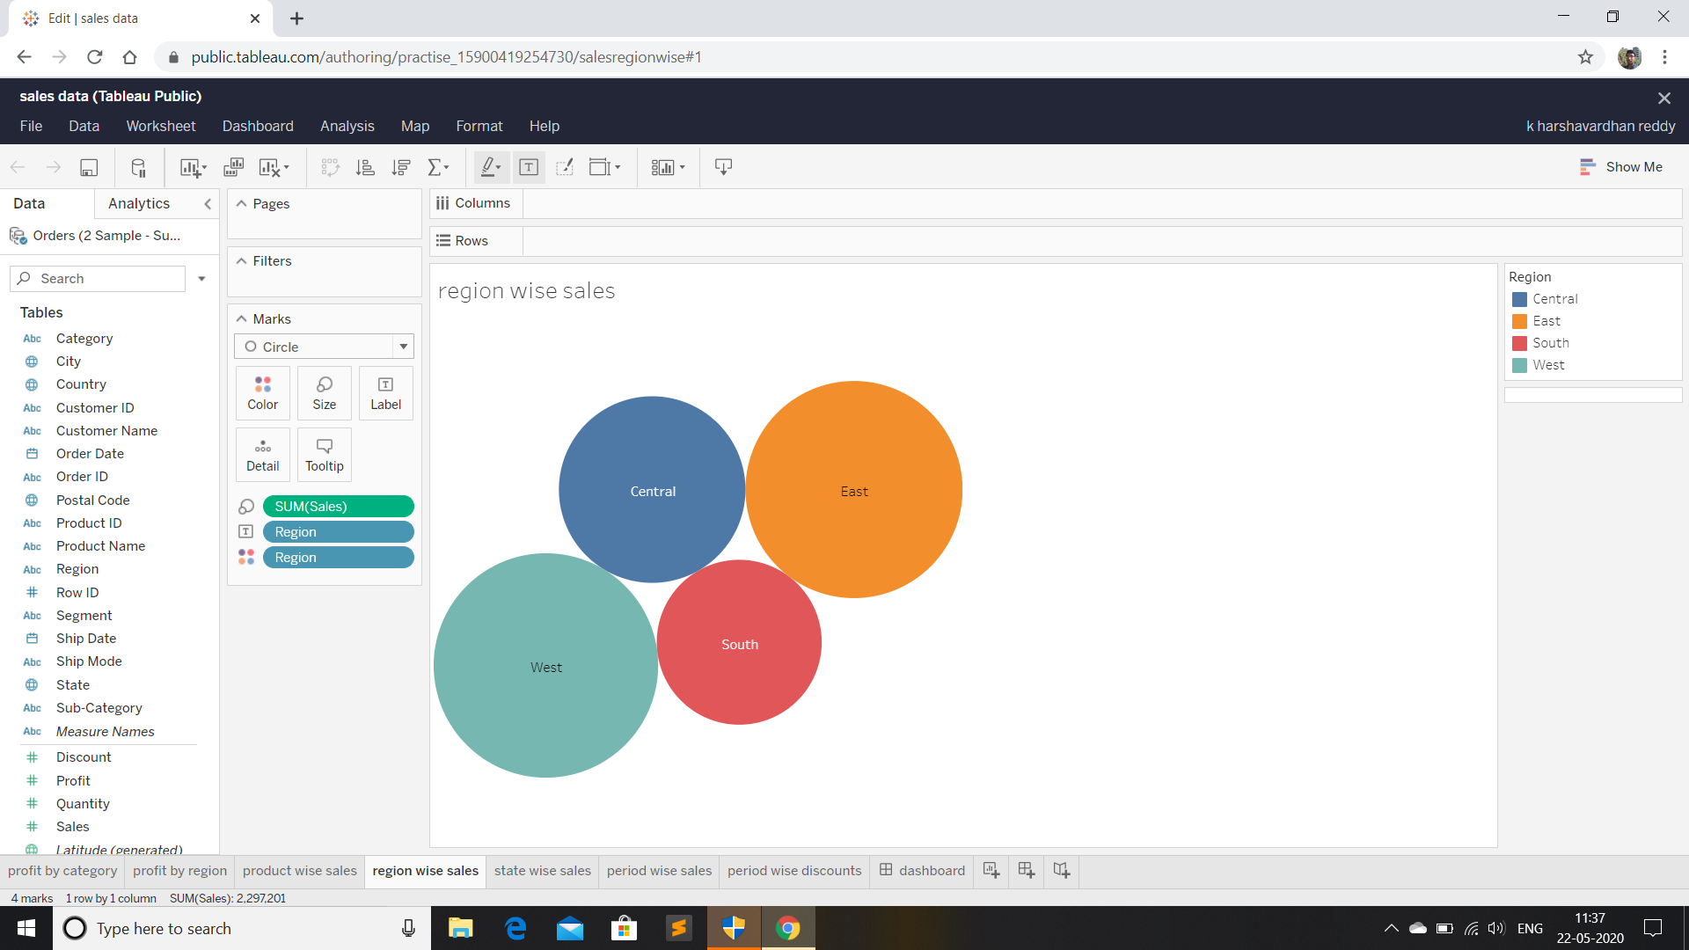
Region wise sales

Slide 14
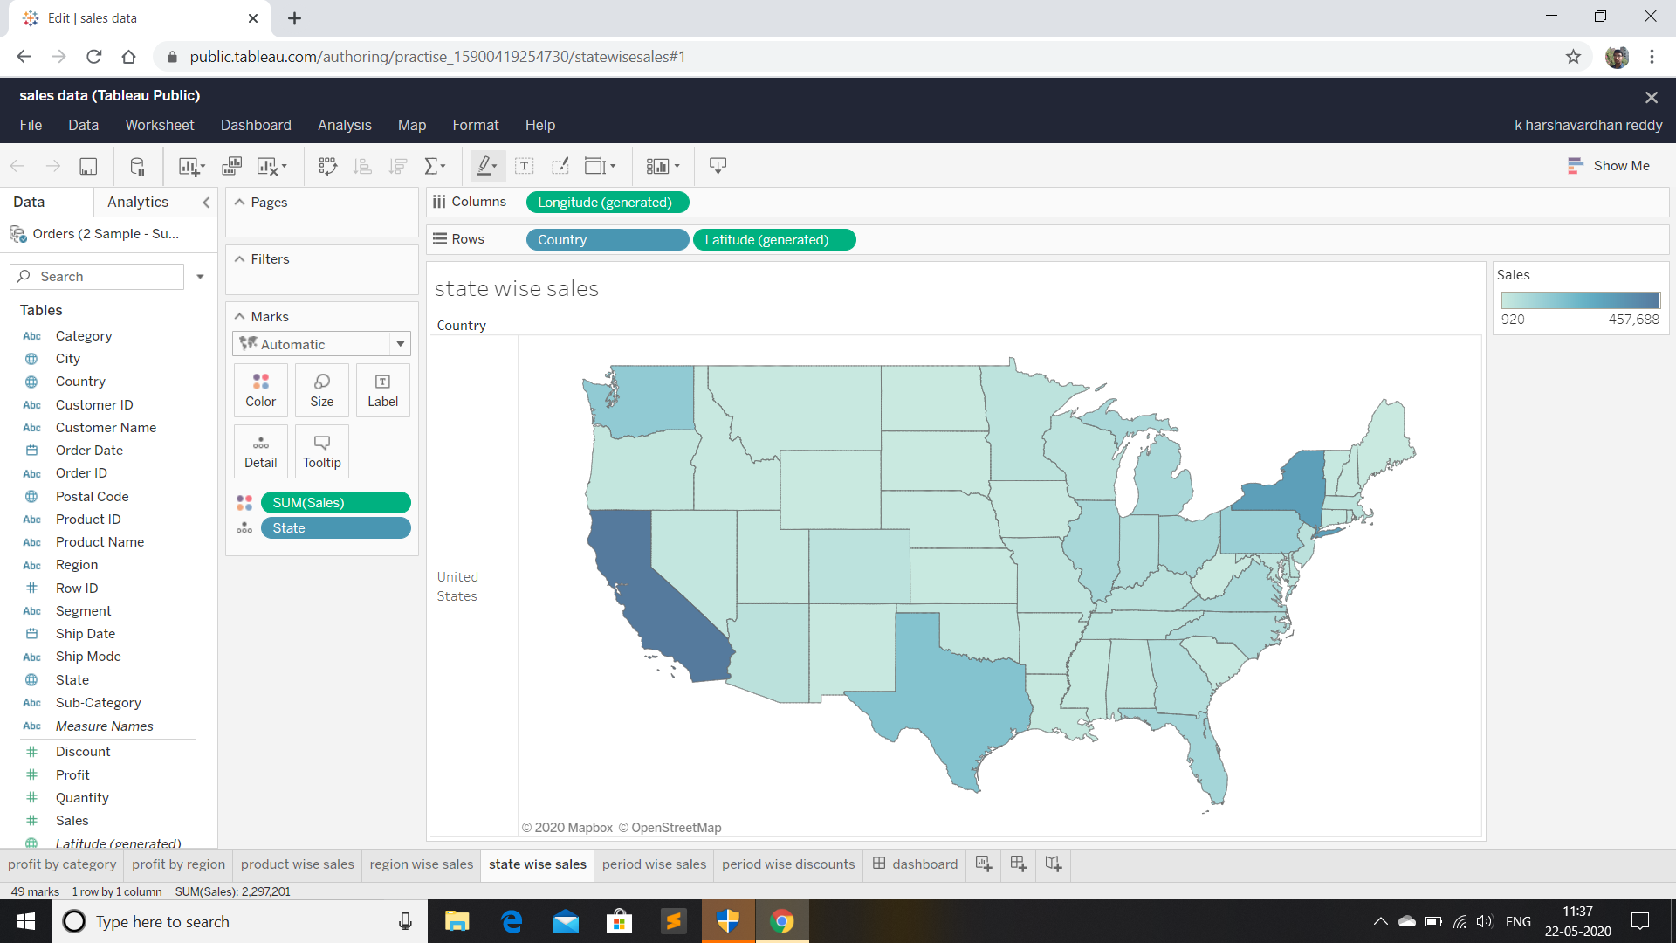
State wise sales

Slide 15
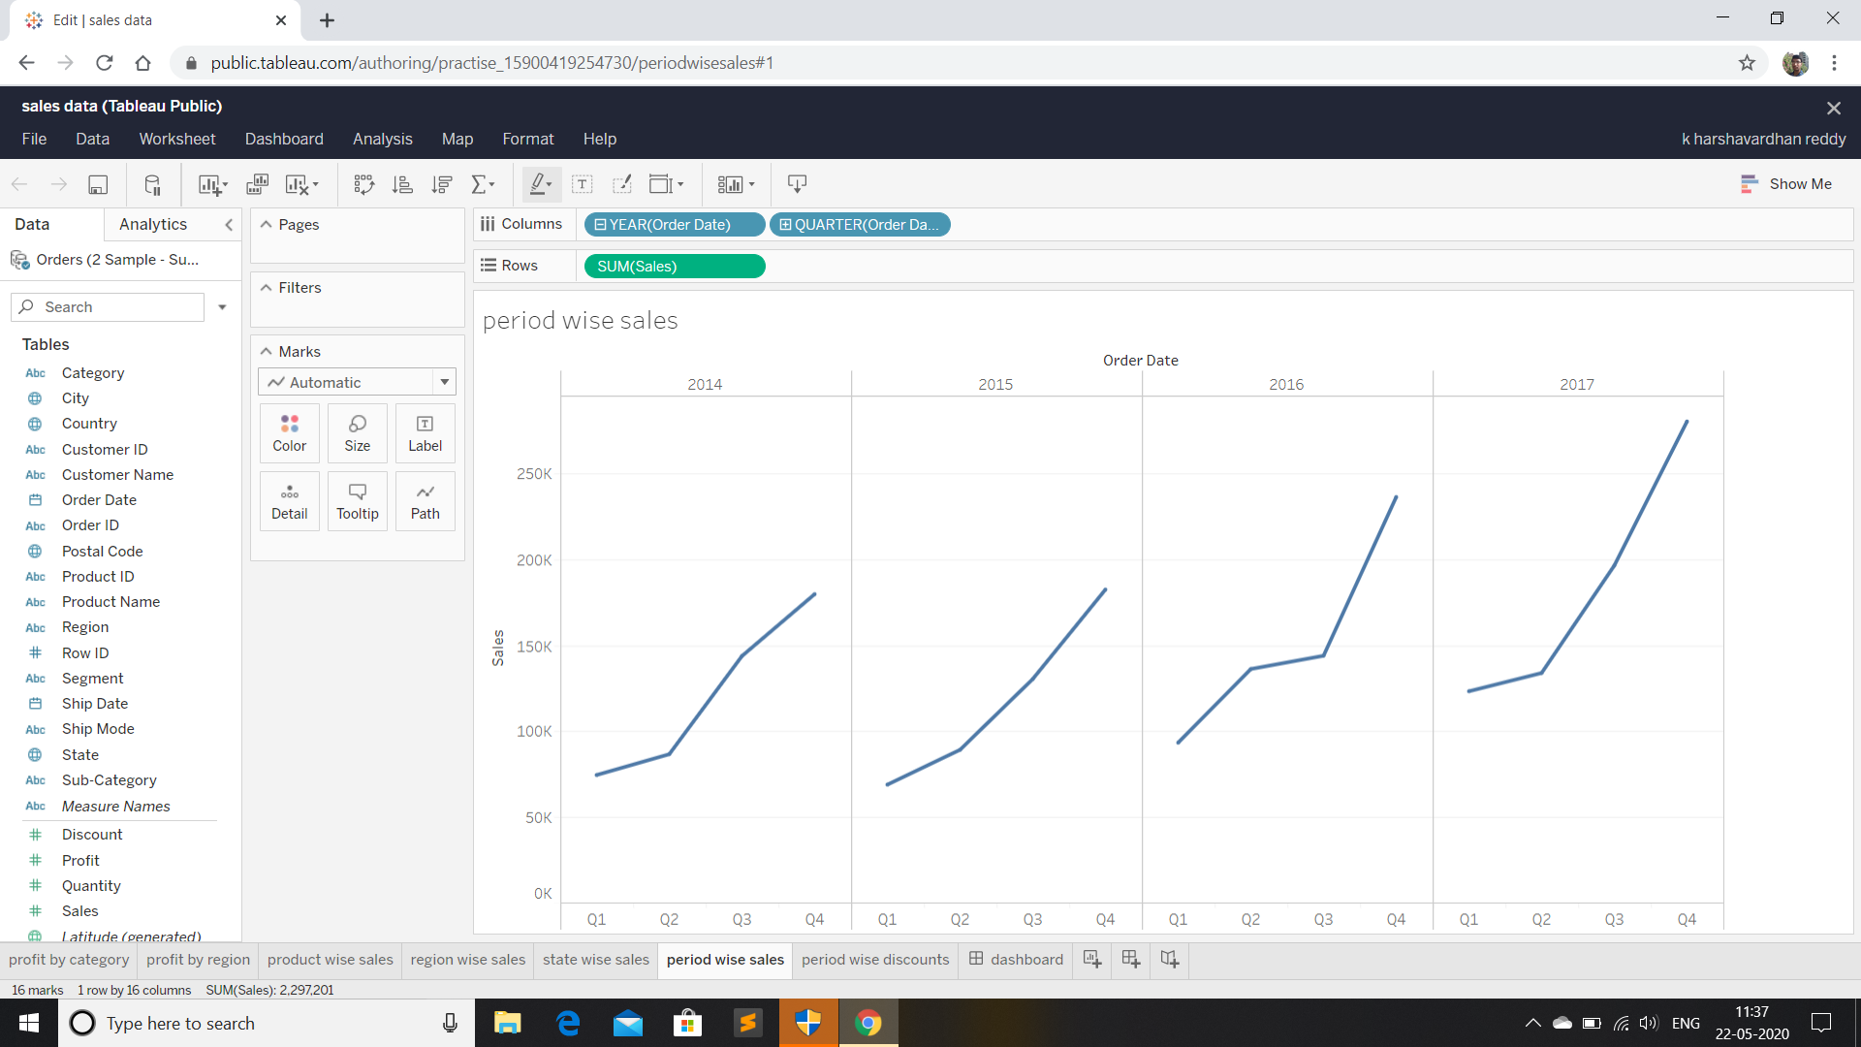
Period wise sales

Slide 16
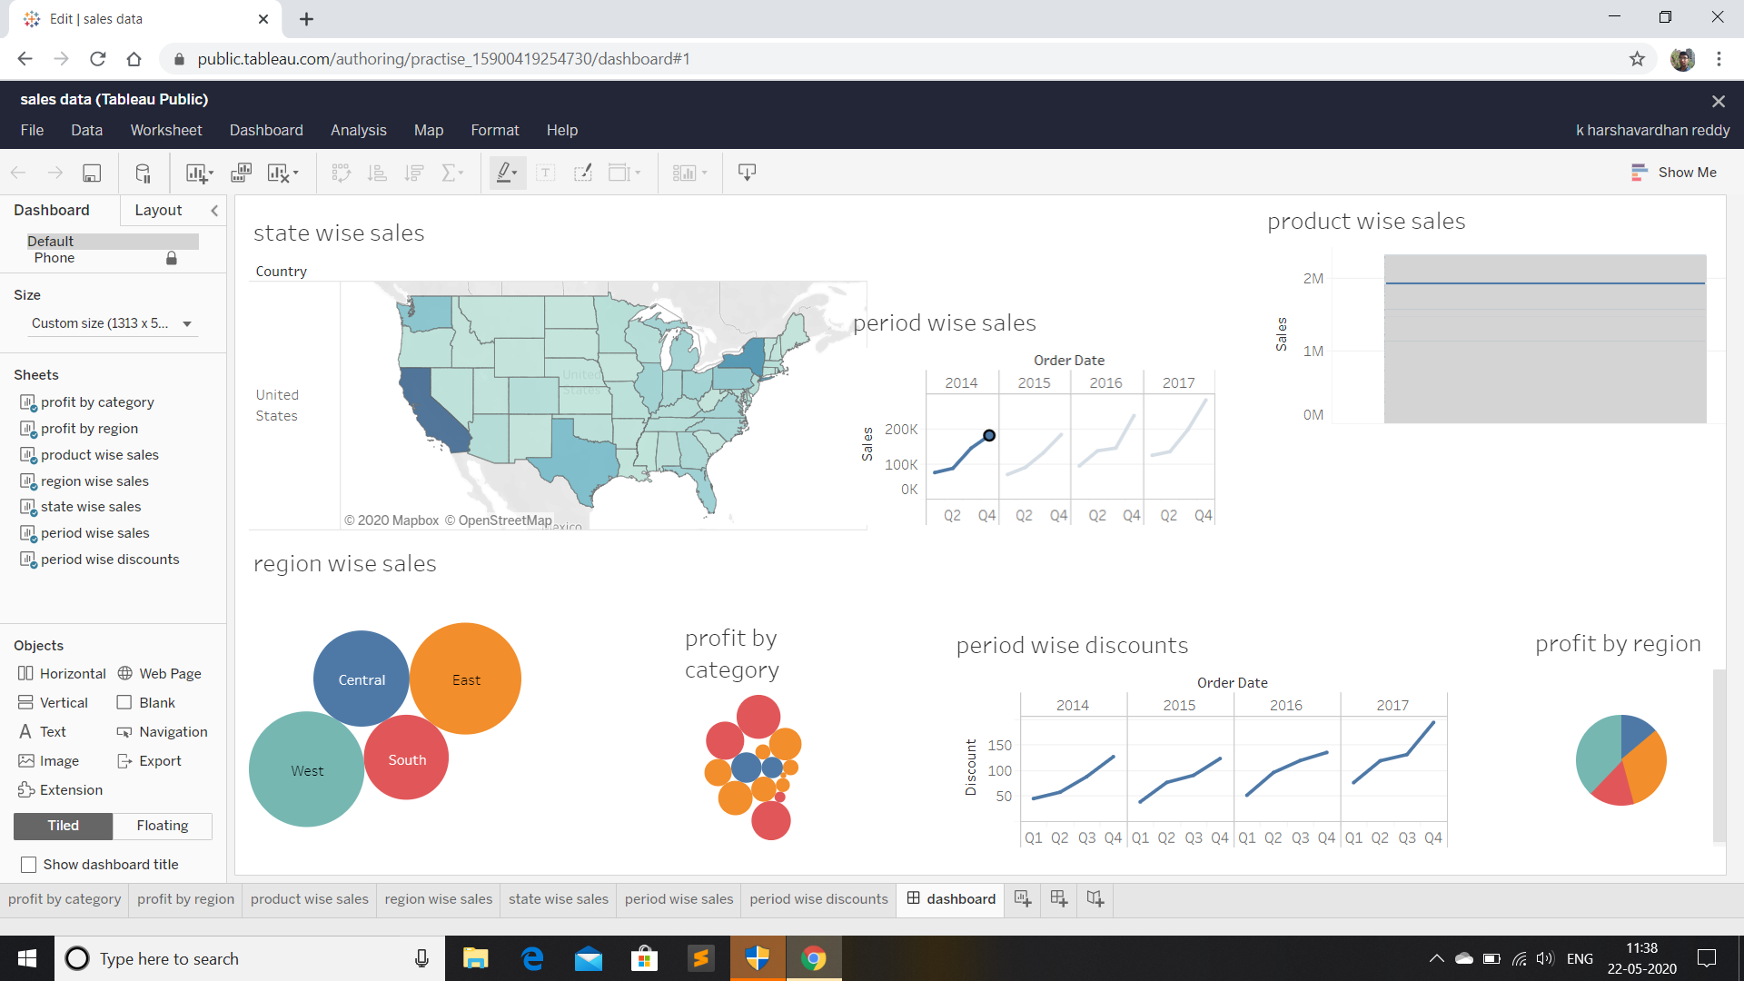
Final dashboard

Slide 17
THANK YOU

